Slide 1
Financial Time Series analysis with machine learning
SIT 723 Research Project A
Satvik Sharma (218595095)

Slide 2
About Financial Time Series
Time Series can be defined as the study of dynamic consequences over a period of time. This presentation focuses on the financial time series, where the study is more concerned with the financial assets like stocks, shares, currency evaluation, et cetera. it is highly logical area, where the uncertainty is extremely high. Financial time series has always been of interest of business and financial analysts because of addition of uncertainty, statistical theory, methods and high volatile market makes financial time series analysis different from regular time series analysis.

Slide 3
Objectives of the Project
Finding patterns
Hybridization
Finding different patterns in different algorithms and different stocks and finding out the similarities and differences in working of each algorithm
Possibility of hybridizing the current algorithms to work optimally.
Portfolios
Future work
Creating long term, mid term, and short term investment portfolios based on the current machine learning and choosing the algorithms that work the best
Finding what can be done in the future in the field of financial time series.

Slide 4
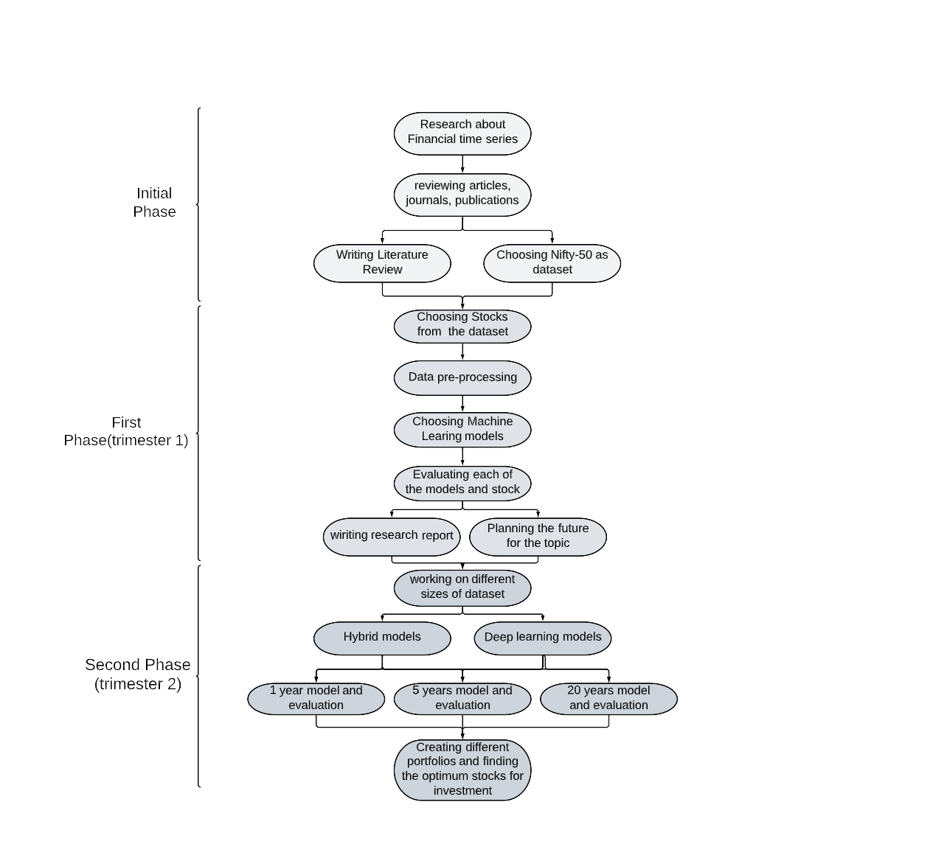
Research design

Slide 5
ML models, Stocks and Evaluation methods used
Auto Regression
ARIMA
ARIMAX
SARIMA
SARIMAX
Holt Winter’s Exponential Smoothing
HDFC
INFOSYS
ICICI Bank
Hindustan Unilever
TCS
Mean Absolute Error
Root mean squared error
R² score

Slide 6
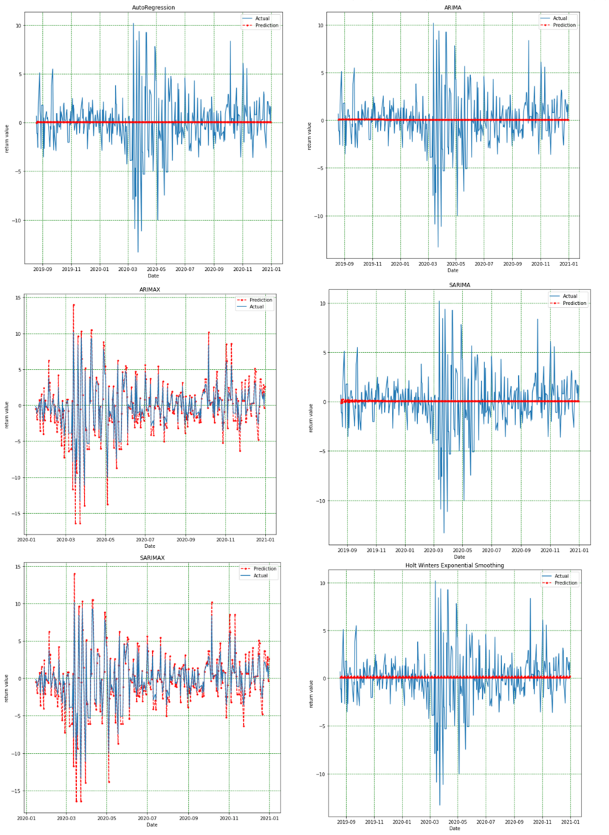
Results and evaluation for HDFC Stock
 | Mean Absolute Error | Root Mean Squared Error | R² score
Auto Regression | 1.8387 | 2.7466 | Negative value
ARIMA | 1.8383 | 2.7465 | Negative value
SARIMA | 1.8398 | 2.7484 | Negative value
ARIMAX | 0.7387 | 1.0684 | 88.29%
SARIMAX | 1.0687 | 0.7388 | 88.28%
Holt Winter’s Exponential smoothing | 1.8409 | 2.7436 | 0.2%

Slide 7
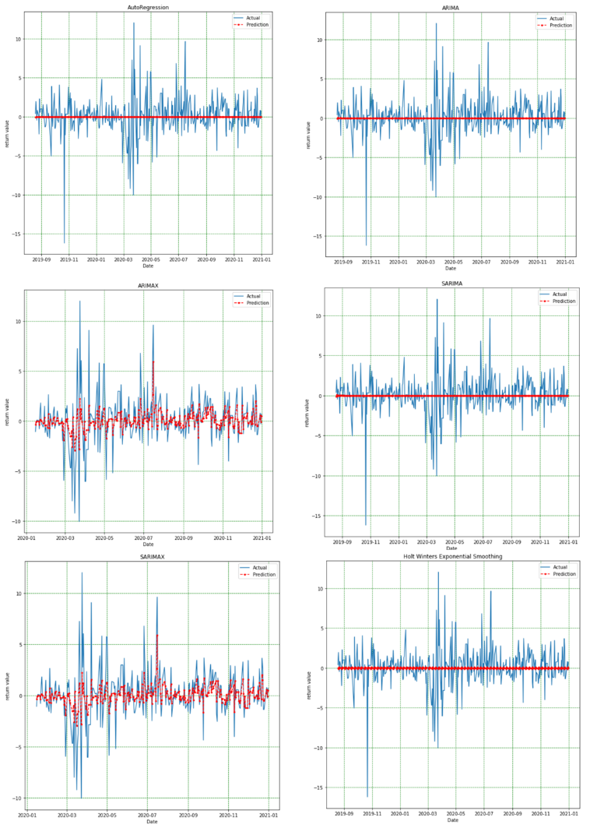
Results and evaluation for Infosys Stock
 | Mean Absolute Error | Root Mean Squared Error | R² score
Auto Regression | 1.6024 | 2.4718 | Negative value
ARIMA | 1.6020 | 2.4717 | Negative value
SARIMA | 2.4712 | 1.6016 | Negative value
ARIMAX | 1.1471 | 1.7900 | 51.67%
SARIMAX | 1.1472 | 1.7902 | 51.66%
Holt Winter’s Exponential smoothing | 1.6017 | 2.4719 | Negative value

Slide 8
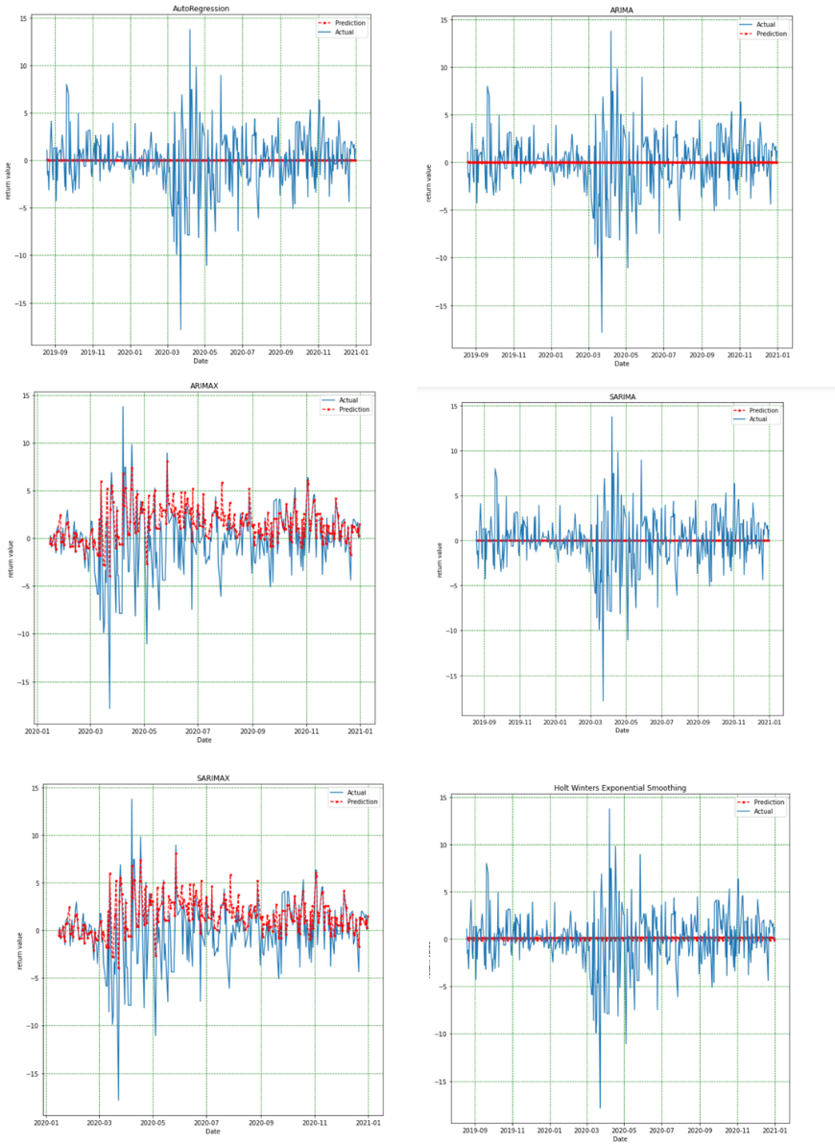
Results and evaluation for ICICI Bank Stock
 | Mean Absolute Error | Root Mean Squared Error | R² score
Auto Regression | 2.1700 | 3.1046 | Negative value
ARIMA | 2.1703 | 3.1047 | Negative value
SARIMA | 2.1726 | 3.1056 | Negative value
ARIMAX | 1.9182 | 2.8441 | 32.53%
SARIMAX | 1.9182 | 2.8441 | 32.53%
Holt Winter’s Exponential smoothing | 2.1619 | 3.0994 | 0.25%

Slide 9
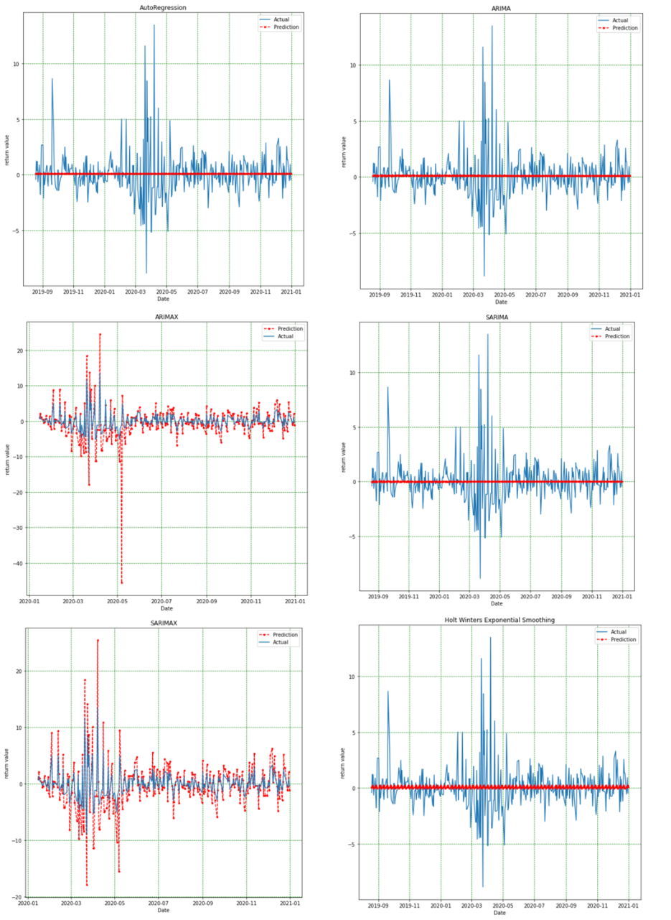
Results and evaluation for Hindustan Unilever Stock
 | Mean Absolute Error | Root Mean Squared Error | R² score
Auto Regression | 1.2637 | 1.9784 | Negative value
ARIMA | 1.2640 | 1.9786 | Negative value
SARIMA | 1.2554 | 1.9788 | Negative value
ARIMAX | 1.5563 | 3.4731 | Negative value
SARIMAX | 1.4158 | 2.2328 | Negative value
Holt Winter’s Exponential smoothing | 1.2542 | 1.9776 | 0.01%

Slide 10
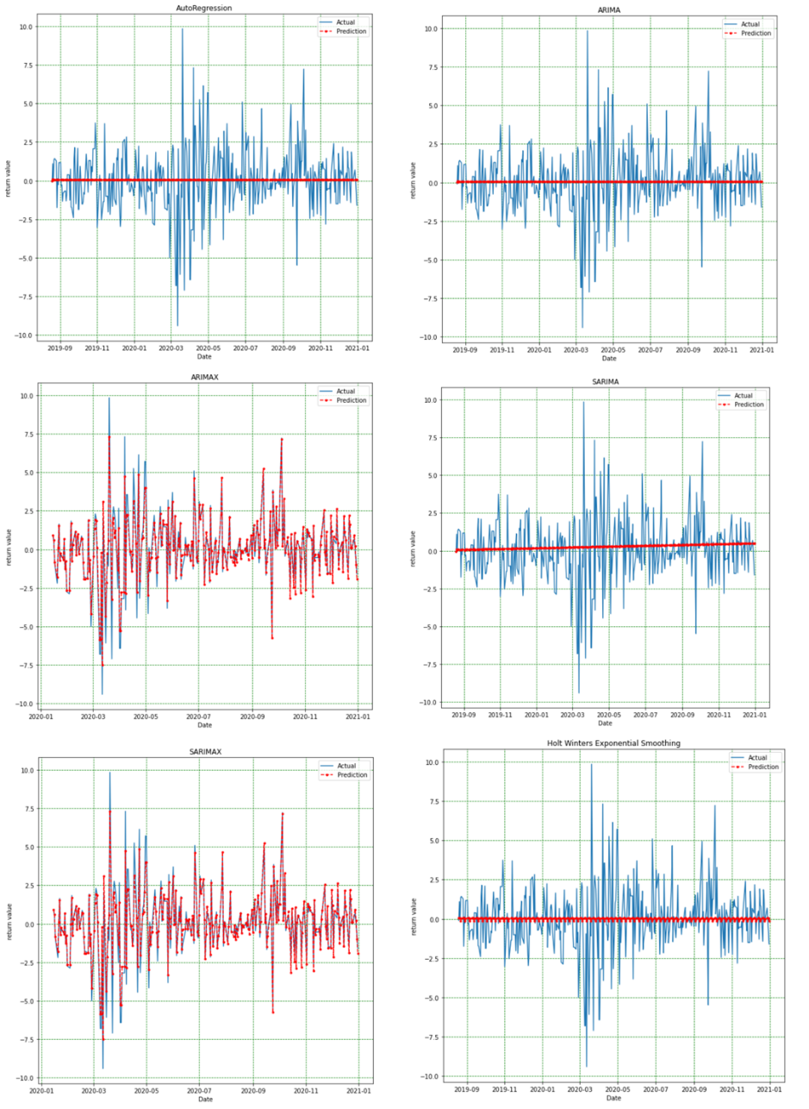
Results and evaluation for TCS Stock
 | Mean Absolute Error | Root Mean Squared Error | R² score
Auto Regression | 1.4590 | 2.1002 | Too big value
ARIMA | 1.4587 | 2.1001 | Too big value
SARIMA | 1.4586 | 2.1009 | Negative value
ARIMAX | 0.3425 | 0.5925 | 93.4738%
SARIMAX | 0.3424 | 0.5936 | 93.4749%
Holt Winter’s Exponential smoothing | 1.4554 | 2.1009 | Negative value

Slide 11
Conclusion
Overall the best working model is ARIMAX.
The worst model that correlates least is SARIMA.
The best results can be seen for the stock TCS.
The worst results can be seen for Hindustan Unilever.
Future Work
Working on different sizes of dataset.
Working on hybrid and deep learning models.
Working on short –term, mid-term and long-term investment portfolios

Slide 12
THANK YOU
Satvik Sharma
218595095

